Slide 1
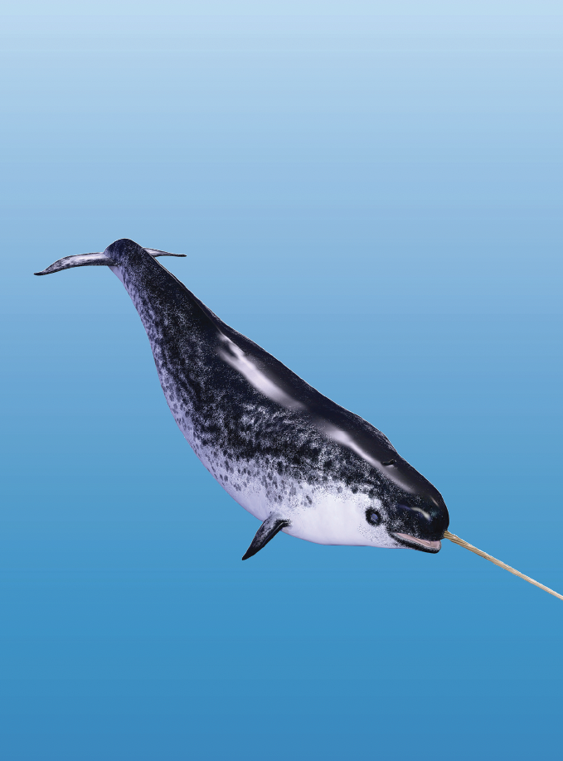
Teaching Resources and Instructors’ Guidelines
Chapter 5: Building the innovative organization

Slide 2
Chapter 5: Building the innovative organization
In the following PowerPoint slides you will find the key headings from CHAPTER 5 together with the main illustrations, tables, etc.
There are also slides summarizing the key messages in bullet-point fashion, and a wide range of activities which you can use to help students explore around these themes.
Finally there are some reflection questions which can be used as the basis for discussion or assignments.

Slide 3
Learning objectives
By the end of this chapter you will understand:
how leadership and organization of innovation is much more than a set of processes, tools and techniques,
how different leadership and creative styles influence the ability to identify, assess and develop new ideas and concepts.
how teams, groups and processes each contribute to successful innovation behaviours and outcomes.
how different environmental factors can support or hinder innovation and entrepreneurship.

Slide 4

Core themes and material from the book

Slide 5
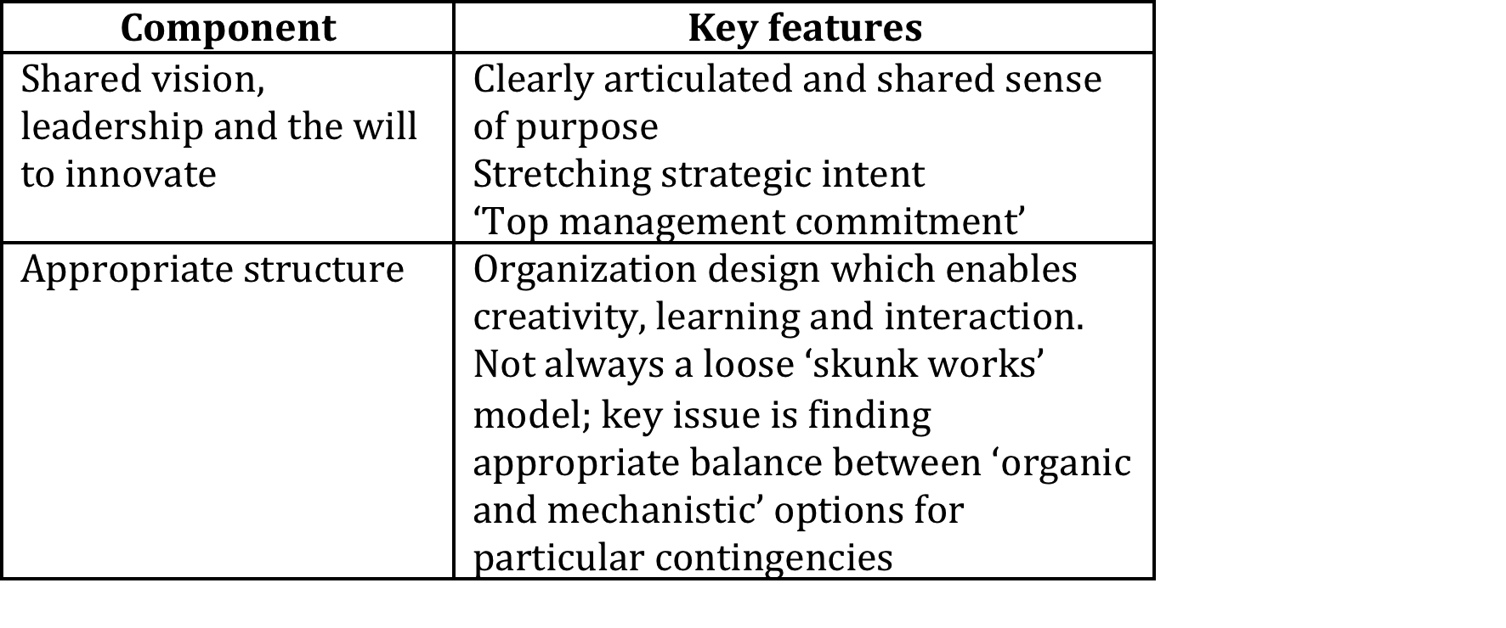
The innovative organization
Research shows these factors are associated with good performance:

Slide 6
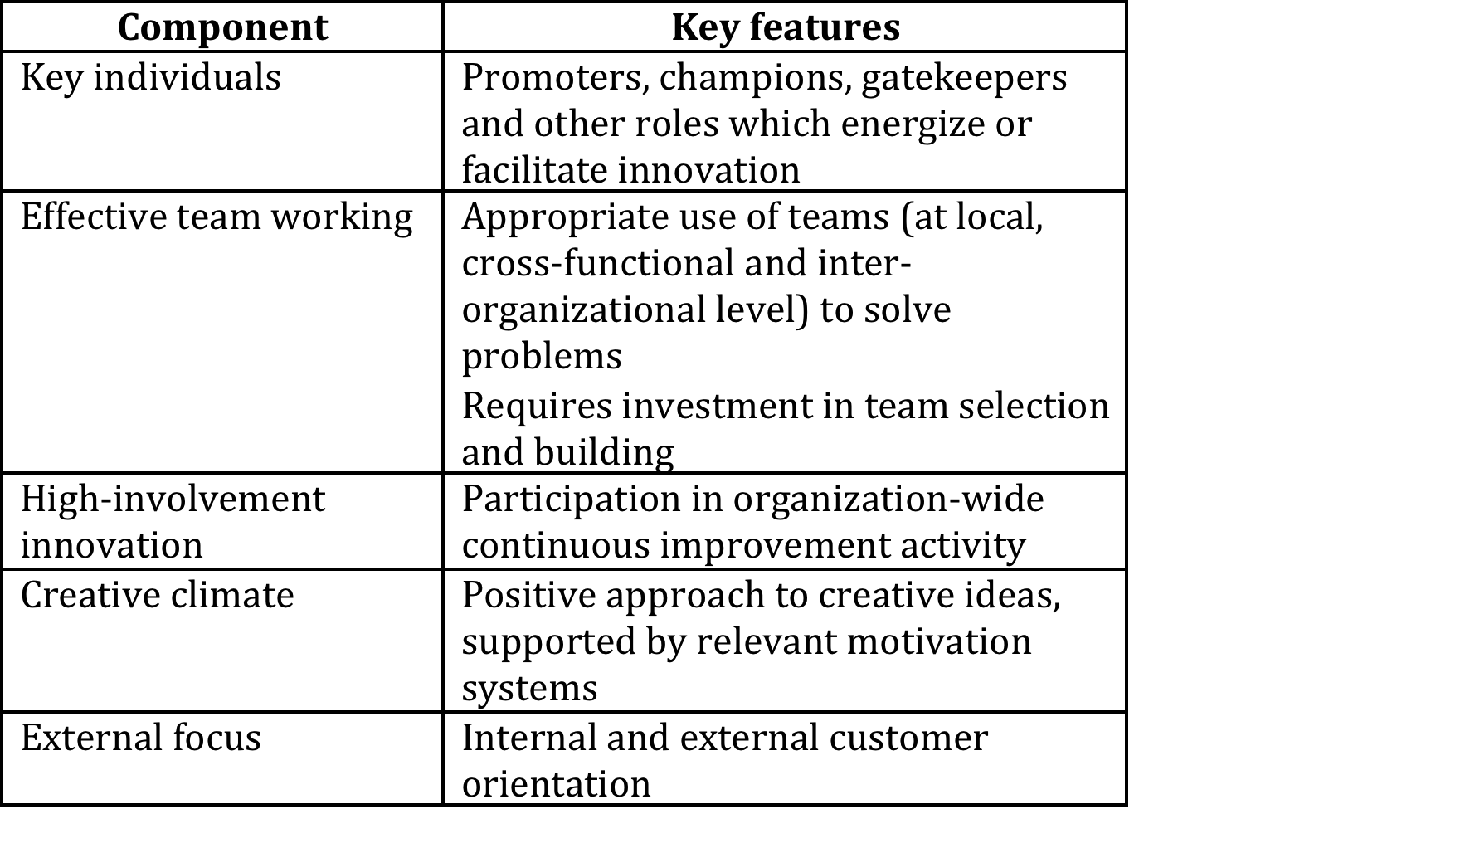
The innovative organization
(continued)

Slide 7

Innovation leadership
Reviews of research on leadership and performance suggest leadership directly influences:
Around 15% of the differences found in performance of businesses;
Contributes around an additional 35% through the choice of business strategy;
So directly and indirectly leadership can account for half of the variance in performance observed across organizations.

Slide 8
Characteristic traits of good leaders
  bright, alert and intelligent;
  seek responsibility and take charge;
  skillful in their task domain;
  administratively and socially competent;
  energetic, active and resilient;
  good communicators.
BUT
There is no brief and universal list of enduring traits that all good leaders must possess under all conditions.

Slide 9
Key factors for leaders to focus on
A review of twenty-seven empirical studies of the relationships between leadership and innovation investigated when and how leadership influences innovation, identified six factors leaders should focus on:
Upper management should establish an innovation policy that is promoted throughout the organization. It is necessary that the organization through its leaders communicate to employees that innovative behavior will be rewarded.

Slide 10
Key factors for leaders to focus on (continued)
2. When forming teams, some heterogeneity is necessary to promote innovation. However, if the team is too heterogeneous, tensions may arise, when heterogeneity is too low, more directive leadership is required to promote team reflection, for example, by encouraging discussion and disagreement.
3. Leaders should promote a team climate of emotional safety, respect, and joy through emotional support and shared decision-making.

Slide 11
Key factors for leaders to focus on (continued)
4. Individuals and teams have autonomy and space for idea generation and creative problem solving.
5. Time limits for idea creation and problem solutions should be set, particularly in the implementation phases
6. Finally, team leaders, who have the expertise, should engage closely in the evaluation of innovative activities.

Slide 12
Creative style
Kirton’s ‘adaptors and innovators’ spectrum:
  Adaptors characteristically produce a sufficiency of ideas based closely on existing agreed definitions of a problem and its likely solutions, but stretching the solutions. These ideas help to improve and 'do better'.
  Innovators are more likely to reconstruct the problem, challenge the assumptions and to emerge with a much less expected solution which very probably is also at first less acceptable. Innovators are less concerned with doing things better than with doing things differently.

Slide 13
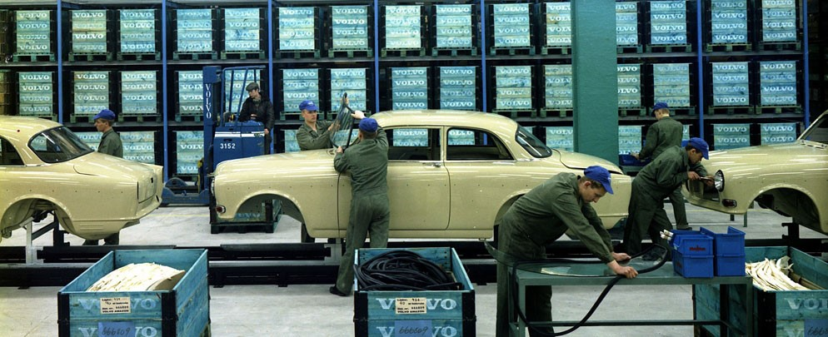
Collective and social aspects of innovation
‘It takes five years to develop a new car in this country. Heck, we won World War 2 in four years...’
Ross Perot’s critical comment on the state of the US car industry in the late 1980s captured some of the frustration with existing ways of designing and building cars.

Slide 14
Collective and social aspects of innovation (continued)
  The power of team working
  Lew Varaldi, project manager of Ford’s Team Taurus project put it, ‘... it’s amazing the dedication and commitment you get from people...we will never go back to the old ways because we know so much about what they can bring to the party...’
  Groups are not necessarily teams….

Slide 15
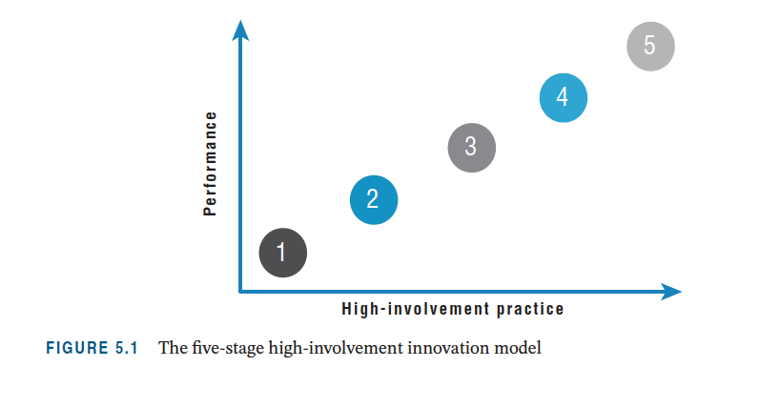
High involvement innovation

Slide 16
Key factors in high performance teams
Key elements in effective high-performance team working include:
  clearly defined tasks and objectives;
  effective team leadership;
  good balance of team roles and match to individual behavioural style;
  effective conflict resolution mechanisms within the group;
  continuing liaison with external organization.

Slide 17
Tuckman’s model of team development
Teams typically go through four stages of development:
  ‘forming,
  storming,
  norming,
  performing’.

Slide 18

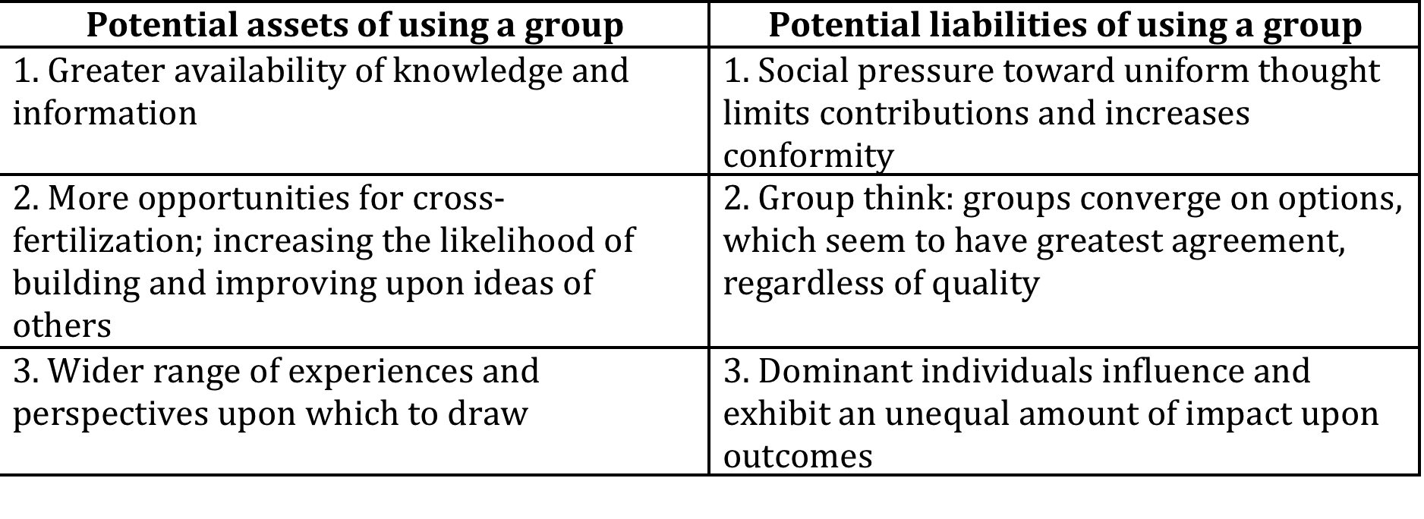
Advantages and disadvantages of groups

Slide 19
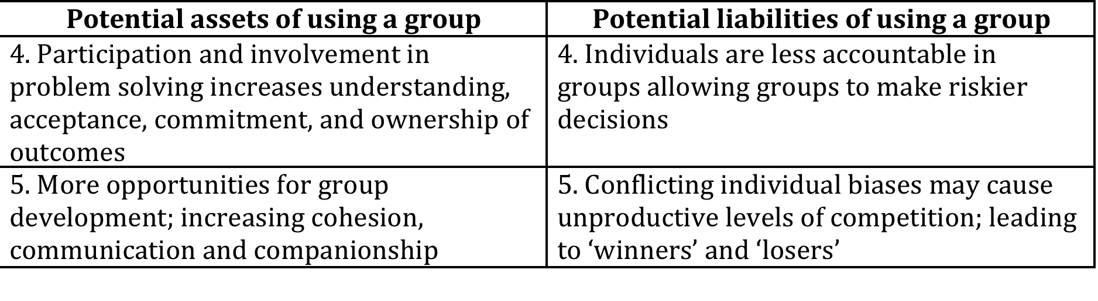
Advantages and disadvantages of groups
Source: S. Isaksen and J. Tidd (2006) Meeting the Innovation Challenge, John Wiley & Sons, Ltd, Chichester

Slide 20
High performing teams
Based on Tidd and Isaksen research, high performing characteristics are:
  a clear, common and elevating goal;
  results-driven structure;
  competent team members;
  unified commitment.
Collaborative climate:
  standards of excellence;
  external support and recognition;
  principled leadership.

Slide 21
High performing teams (continued)
Based on Tidd and Isaksen research, appropriate use of the team:
  participation in decision making;
  team spirit;
  embracing appropriate change.

Slide 22
‘Tripwires’ undermining team effectiveness
  group versus team;
  ends versus means;
  structured freedom;
  support structures and systems;
  assumed competence.

Slide 23
Context and climate
Climate is defined as the recurring patterns of behaviour, attitudes and feelings that characterize life in the organization.
Objectively shared perceptions that characterize life within a defined work unit or in the larger organization.
Climate is distinct from culture in that it is more observable at a surface level within the organization and more amenable to change and improvement efforts.
Culture refers to the deeper and more enduring values, norms and beliefs within the organization.

Slide 24
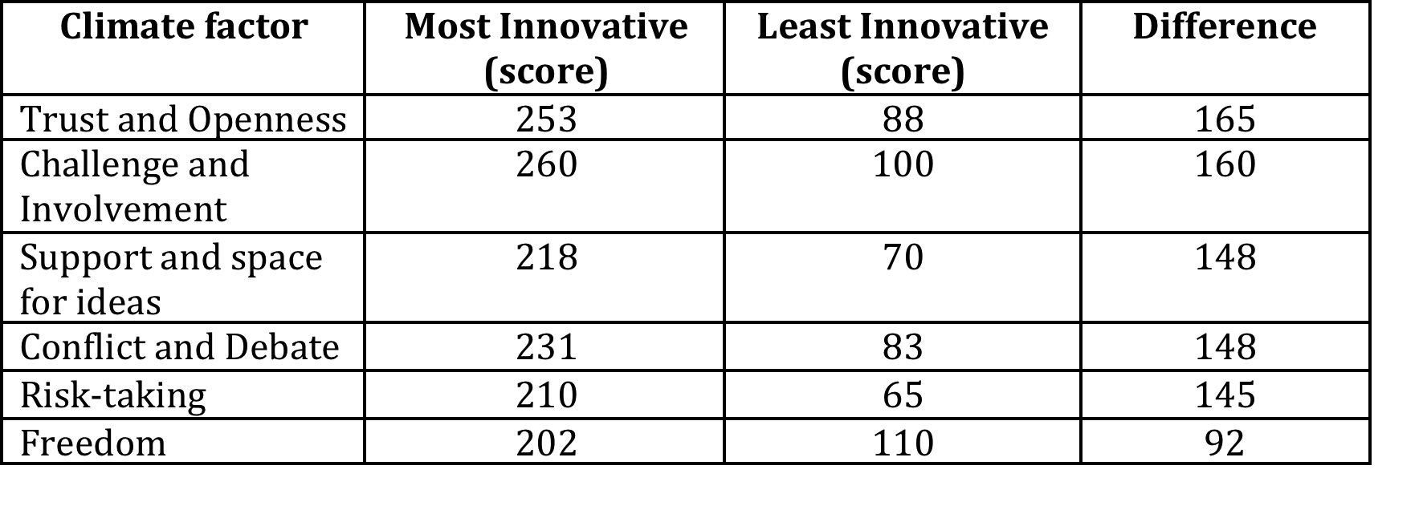
Climate factors influencing innovation
Source: Derived for Scott Isaksen and Joe Tidd (2006) Meeting the Innovation Challenge (Wiley).

Slide 25
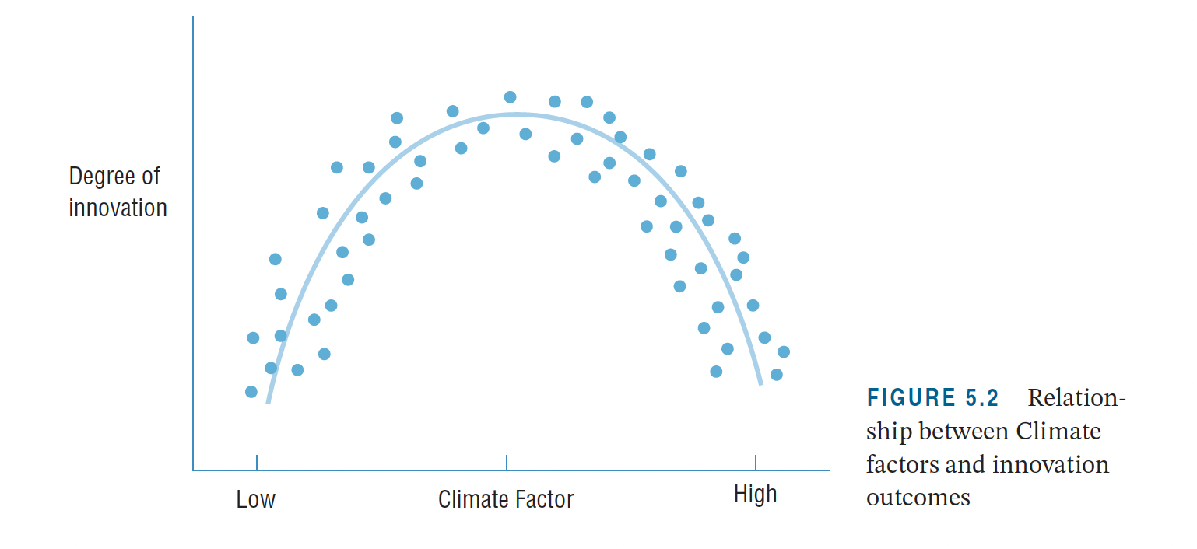
Climate factors and innovation

Slide 26
Summary
Leadership and organization of innovation is much more than a set of processes, tools and techniques, and the successful practice of innovation demands the interaction and integration of three different levels of management, individual, collective and climate.

Slide 27
Summary
At the personal or individual level, the key is to match the leadership styles with the task requirement and type of teams. General leadership requirements for innovative projects include expertise and experience relevant to the project, articulating a vision and inspirational communication, intellectual stimulation, and quality of leader-member exchange (LMX).

Slide 28
Summary
At the collective or social level, there is no universal best-practice but successful teams require clear, common and elevating goals, unified commitment, cross-functional expertise, collaborative climate, external support and recognition and participation in decision making.

Slide 29
Summary
At the context or climate level, there is no “best innovation culture”, but innovation is promoted or hindered by a number of factors, including trust and openness, challenge and involvement, support and space for ideas, conflict and debate, risk-taking and freedom.

Slide 30

Videos
There are several videos which can help explore and present the key themes of the chapter:
Building the innovative organization part 1
Building the innovative organization part 2
Piers Ibbotson talking about leadership
Patrick McLoughlin on leadership
Victor Cui on organizing a startup
Tidewave as a start-up organization
Melissa Clark-Reynolds on her start-up
Notes:
Short videos

Slide 31
Videos
Hugh Chapman, Managing Director of Veeder Root on innovation leadership
Emma Taylor of Denso Systems on employee involvement
Armin Rau, Strategy Partner of Sicap.

Slide 32
Videos
Douglas Merril of Google who explains a little about how the organization supports innovation
Linda Hill’s TED Talk on collective creativity
https://www.ted.com/talks/linda_hill_how_to_manage_for_collective_creativity
Four cases of employee involvement in innovation

Slide 33
Blogs and podcasts
There are several podcasts picking up key themes around managing innovation as a process and some of the key variables:

Slide 34
Activities
There are a variety of activities (for both groups and individuals and for online as well as offline work. These include:

Slide 35

Activity: Innovation leaders
Ask students to search the web and find examples of innovation leaders and what they do, what they seem to focus on, how they lead? And what don’t they do?
E.g. Steve Jobs an entrepreneur who revolutionized six industries: personal computers, animated movies, music, phones, tablet computing, and digital publishing; OR
Larry Page (Google), Jeff Bezos (Amazon), Bill Gates (Microsoft), etc.

Slide 36
Activity: Ken Robinson
Watch the excellent TED talk by Sir Ken Robinson and try to distil the key points he makes about creativity and creative environments.
How far do you agree or disagree?
Give examples to support your arguments.

Slide 37
Activity: Self – assessment – how creative are you?
Ask students to complete the questionnaire on the website here, being as honest as possible.
Then calculate your score using the guide in the answer.
How innovative are you?

Slide 38
Activity: Uses for….
This activity demonstrates the different contributions people can make to creativity and how groups can generate more ideas, more different ideas and stimulate each other.

Slide 39
Cases
There are several case studies on the website which highlight key themes in the chapter, including:
More detail on the emergence of mass production can be found in the case study of Model T Ford
• The Cerulean case looks in more detail at the challenges of creating a climate for radical innovation
• The Liberty Global and Lufthansa Systems cases look at attempts to build a high involvement culture using collaboration platforms
The Philips Lighting case highlights the organizational challenges of changing the degree and direction of innovation strategy.

Slide 40
Case: Philips Lighting
On the Portal there is a case study of innovation within Philips Lighting which explores the issues of how does an organization jump the tracks? How can it switch off its immune system and open itself up to new – and potentially dangerous – inputs? How can it reframe, let go of its old ways of looking at the world and take on something which is very new – but by definition untried and risky?

Slide 41
Case: Philips Lighting
In this video Joe Tidd discusses innovation leadership, teams and culture in the case of Philips Lighting
https://www.youtube.com/watch?v=cuT2WuJwnLI

Slide 42
Tools
There are many tools to help work with themes raised in this chapter – you can find them here in the toolkit.
In particular:
Change management
Continuous improvement toolkit
High involvement maturity model
Process mapping
Team building

Slide 43
Tools: Belbin’s team roles
On the website there is a description for the tool – Belbin’s roles – and this is a link to a questionnaire designed to identify your role type.
http://stellarleadership.com/docs/Team%20Working/assessment/Team%20Roles%20Questionnaire.pdf

Slide 44
Tool/activity: High involvement innovation
There is also a tool (high involvement innovation audit) which enables exploration and reflection around this issue:

Slide 45
High involvement innovation
Follow the link below to hear an audio interview with David Overton, of Ordnance survey, discussing some of the issues around developing an open innovation strategy in a large public sector organization in the UK.

Slide 46
High involvement innovation
Follow the link below to hear an audio interview with Dr Tim Craft, a consultant anaesthetist and also user-innovator who founded a business, AMS Ltd, based on his experiences in hospitals.

Slide 47
Assessments
The following slides offer some example assessment questions and discussion themes for individual or group activity

Slide 48
Assessment questions
What is innovation leadership? Will leadership processes, tools, techniques, etc. differ in innovative organisations?
2. List characteristic traits of good (bad) leaders. Illustrate your argument with examples from business practice.

Slide 49
Assessment questions
What are the key factors for leaders to focus on. How can you differentiate these factors for upper, middle, and lower management leaders?
4. Imagine Nick Smith has just been promoted inside a big company and his new tasks are to create high performing teams and organizational climate for innovation. Prepare the presentation of Nick’s programme that he has to propose.

Slide 50
Assessment questions
5. Why is the creative style of an individual more important than any assessment of absolute creativity?
6. What are the relevant influences of an individual’s characteristics and their environment on entrepreneurship?
7. What is the difference between culture and climate, and why is this distinction critical for innovation and entrepreneurship?

Slide 51
Assessment questions
8. What factors contribute to the development of a creative climate – and what factors might block it?
9. A team is much more than a group of people brought together. What factors contribute to effective teams and how might you go about building a high performing innovation team using this information?

Slide 52
Team project exercises
Ask students to get together and organize a workshop in groups:
Workshop 1:
Take characteristic traits of good leaders (slide 7) and continue the list. Think of as many traits that all good leaders must possess under all conditions and classify them. Prepare a presentation.
Workshop 2:
Think of personal and individual level of an environment that will support the ability to identify, assess and develop new ideas and concept. List conditions that will foster (hinder) the motivation to develop new ideas on an individual level inside organization.

Slide 53
Team project exercises
Choose an organization and research how it has built up a culture to support innovation. Use concepts from the chapter like leadership, team working, culture, climate, etc.
Prepare a presentation drawing out the key success factors
(A good example would be 3M which is widely documented and has built up a clear approach to organizing innovation which maximizes employee creativity and channels it effectively).

Slide 54
Team project exercises- Creativity
Propose some new services for mobile telephony. Use each of the following six methods to help to provoke alternatives:
Remove or suspend an assumption or goal – what could we do differently if we temporarily ignore a key objective or assumption?
Reverse objectives or methods – what would we do to achieve the exact opposite, and then reverse this?
Exaggerate the problem or goal – what might we do if the goal or problem was much larger or smaller?

Slide 55
Creativity exercises (continued)
Distort the relationships or cause and effect – what would the implications be?
Generate random inputs – what new ideas does the introduction of a random word help create?
Use a metaphor or character – what would a chosen famous character do in these circumstances?

